Slide 1
Digital Filmmaking
Telling Stories through Technology

Slide 2
Composition:
Rule of Thirds

Slide 3
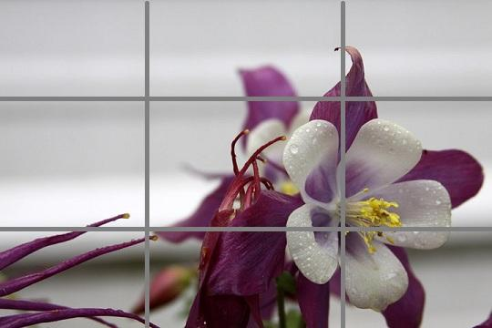
Rule of Thirds
The rule of thirds is the idea that in composing your shot, you should imagine lines dividing the image into thirds both horizontally and vertically, and align your main compositional elements along these lines.
For example, in this shot, notice how the center of the flower is aligned with the left most and bottom most lines.

Slide 4
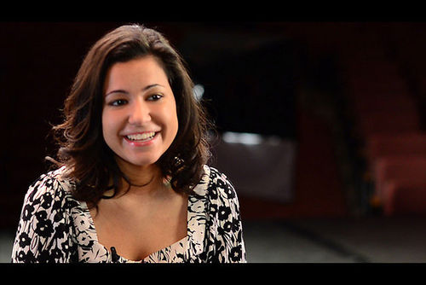
Rule of Thirds
This also applies in shooting human subjects.
The subject should be positioned along one of the vertical lines.
Positioning your subject dead center has an unsettling effect and should be avoided unless you want to use that effect to your advantage.

Slide 5
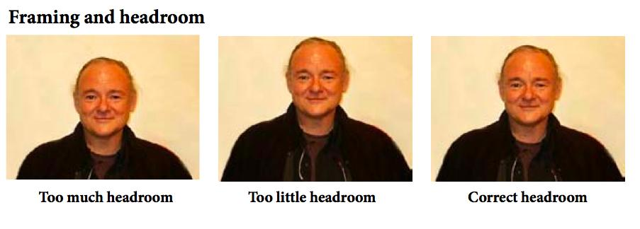
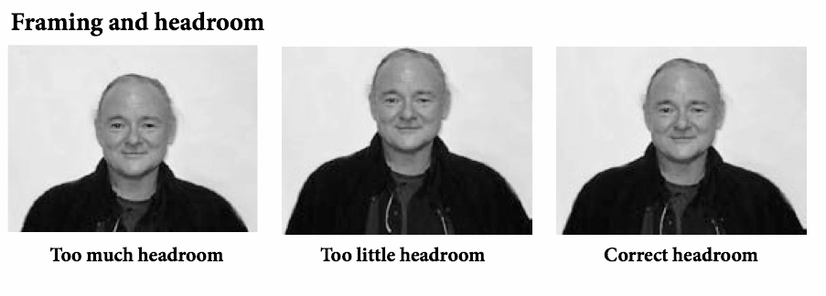
Headroom
Headroom should follow the rule of thirds as well. Here, notice how the subject’s eyes are aligned with the top most divider.

Slide 6
Pans, Tilts, Tracking & Movement
Make sure that all your movement is deliberate.
In general, it’s better to let your subjects move in and out of the frame than to follow them as they are moving.
Tilt: moving the camera up and down
Pan: moving the camera from side to side
Tracking: moving the camera along with your subject as they move

Slide 7
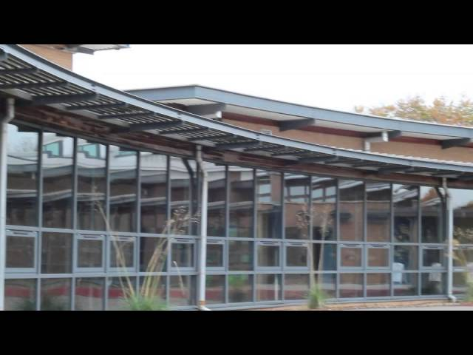

Slide 8
Types of Shots

Slide 9
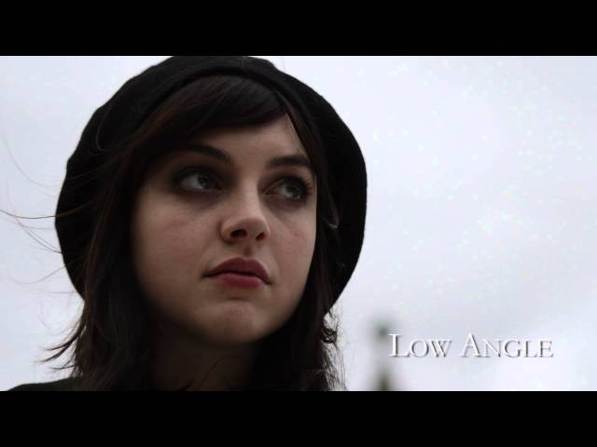
Types of Shots

Slide 10
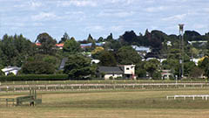
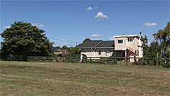
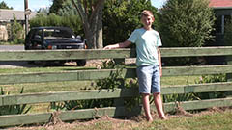
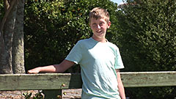
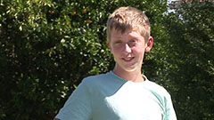
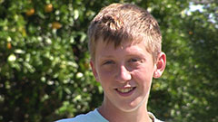
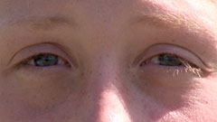
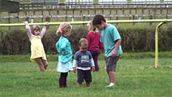
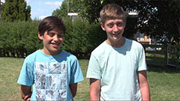
Establishing shot
Very wide shot
Wide shot
Medium shot
Medium close up
Close up
Extreme close up
Cutaway / POV
Two-shot

Slide 12
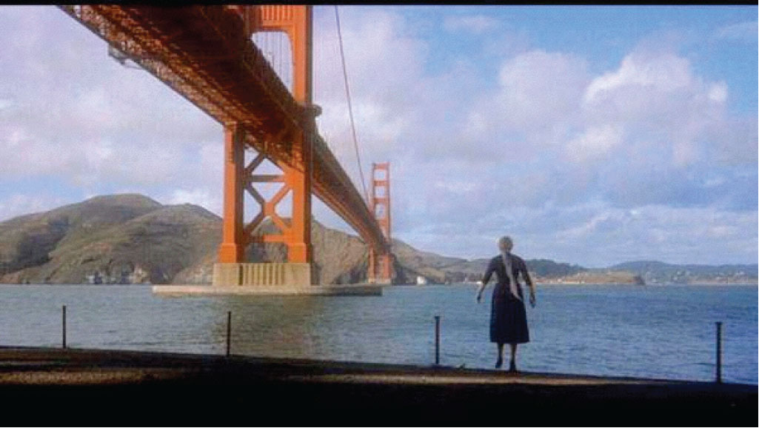
Wide Shot

Slide 13
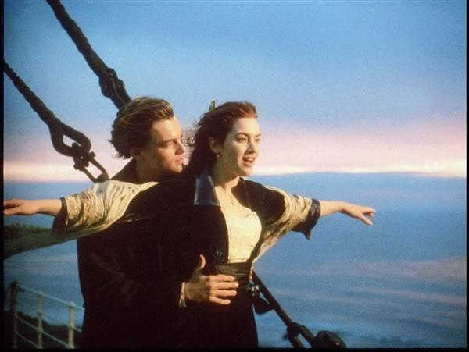
Medium Shot

Slide 14
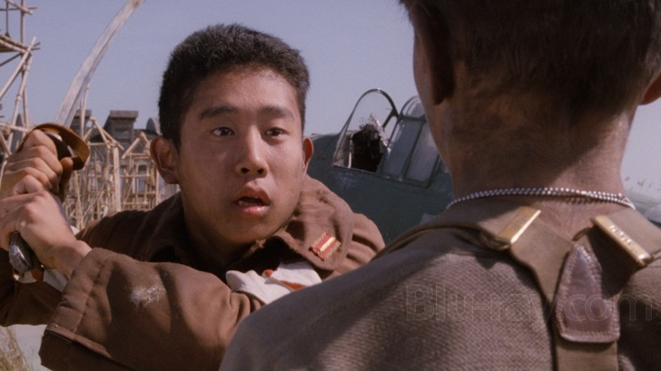
Over the Shoulder Shot

Slide 15
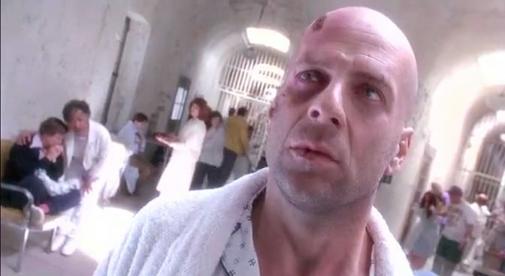
Dutch Angle

Slide 16
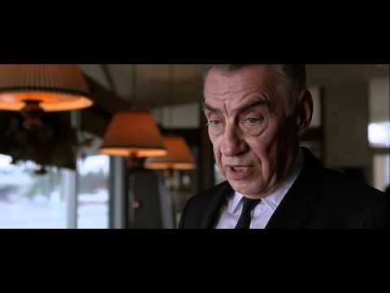
Shot Reverse Shot
Notes:
Shot Reverse Shot in hardball eight. With a medium two person shot in between.

Slide 17
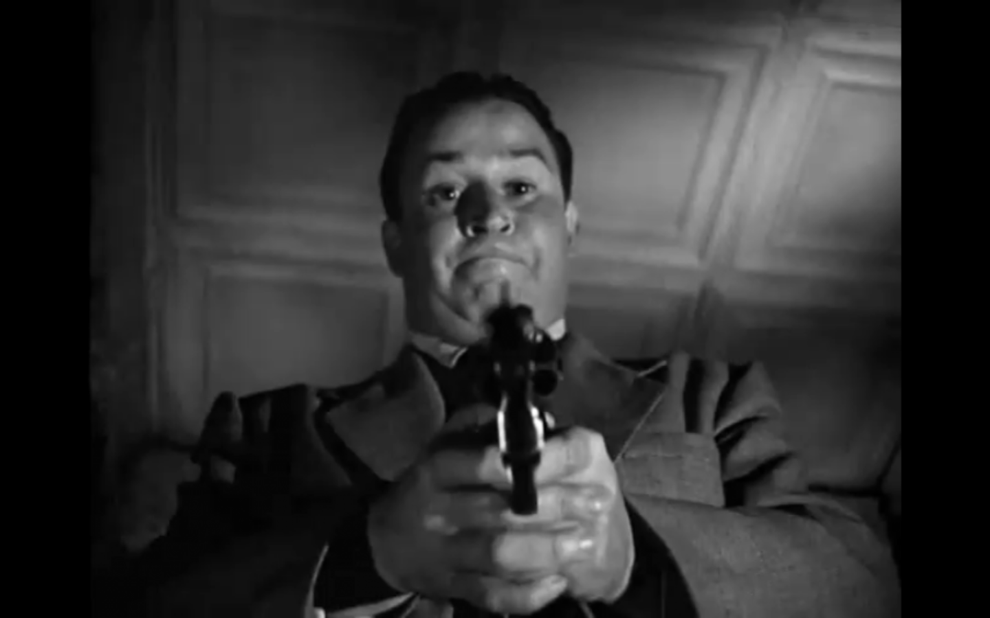
Point of View (POV) Shot

Slide 18
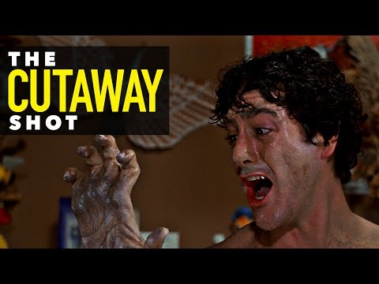
Cutaway Shot

Slide 19
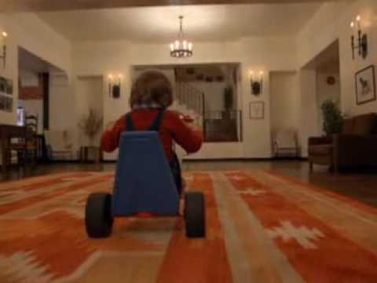
Tracking Shot

Slide 20
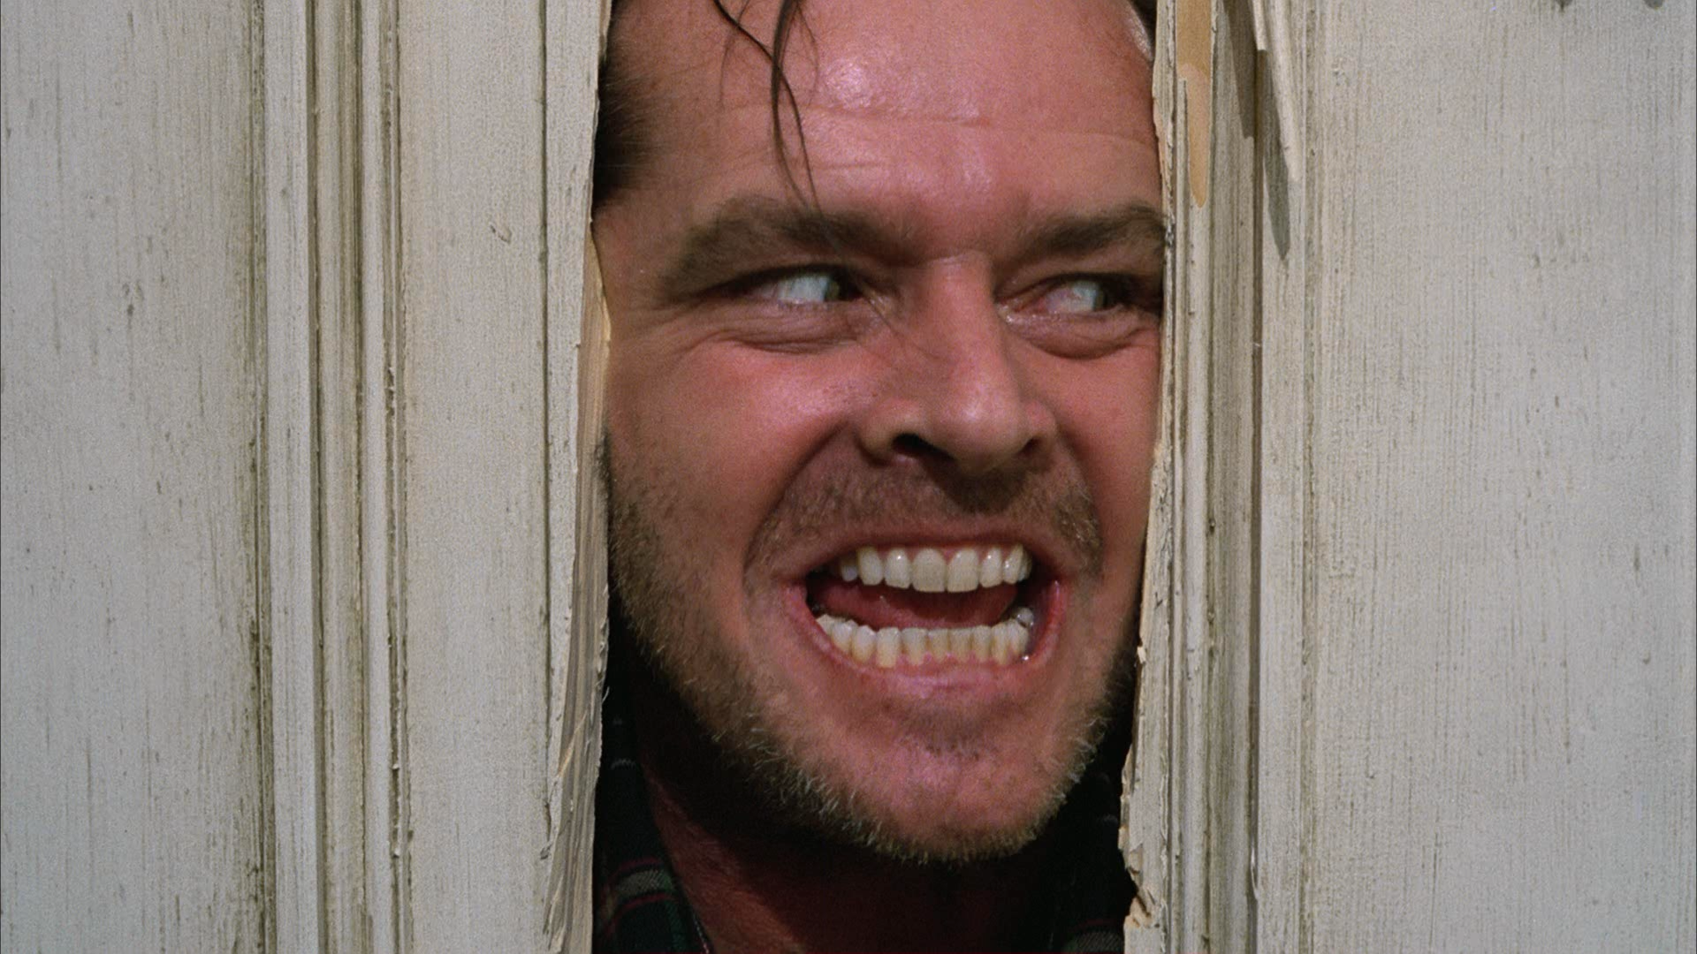
Close-up Shot

Slide 21
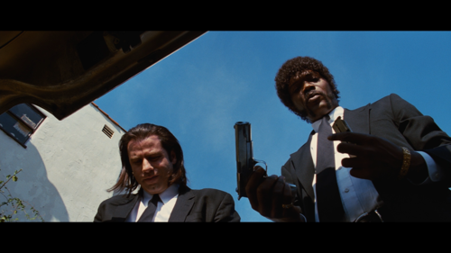
Low Angle Shot

Slide 22
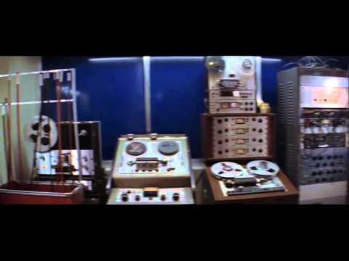
Panning Shot

Slide 23
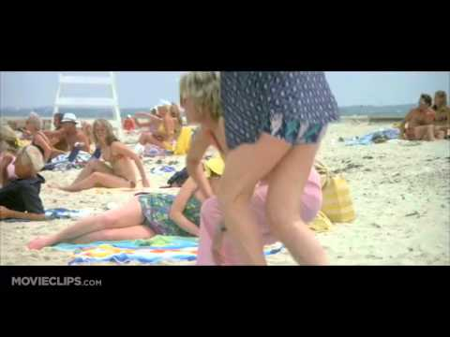
Zoom and Dolly Shots

Slide 24
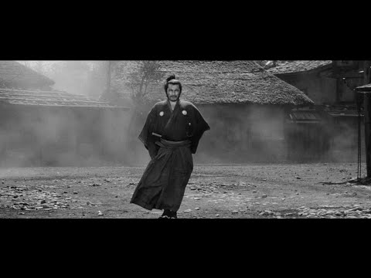
Composing Movement

Slide 25
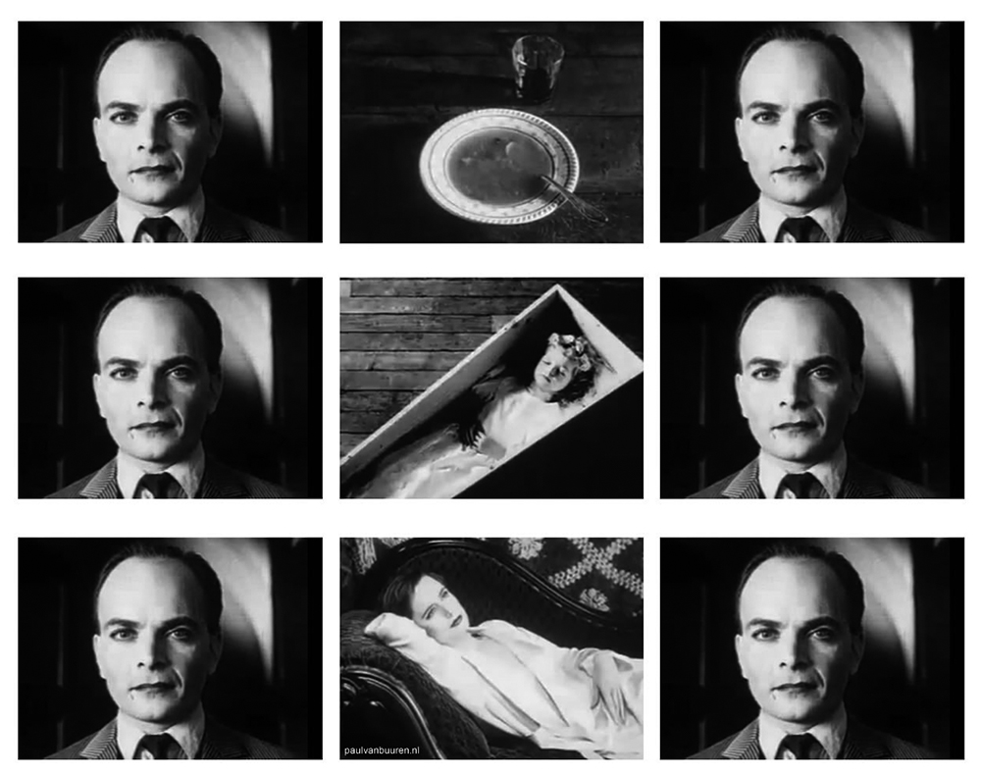
The Kuleshov Effect

Slide 27
STORYBOARDING

Slide 28
Storyboarding
Each panel in a storyboard shows the shot, the characters or scene elements within the frame, information about the scene and context as well as any dialogue or audio if it goes with the scene.
They can range from informal rough sketches with a few notes to incredibly complex and rich ones.
As a general rule, there needs to be one panel for every shot and/or line of dialogue, whether you intend to follow this exactly or not.

Slide 29
General rule:
One panel per shot and / or line of dialogue.

Slide 30
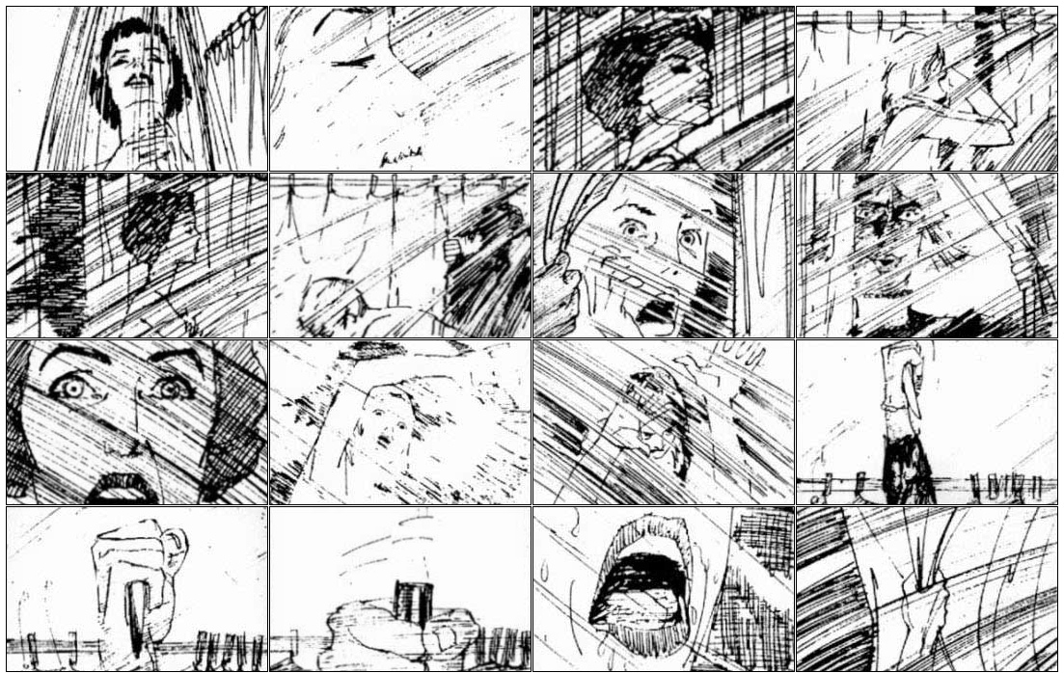
Storyboard
Storyboard for the shower scene of Psycho (1960), Alfred Hitchcock.
Note how every shot is laid out one by one.

Slide 31
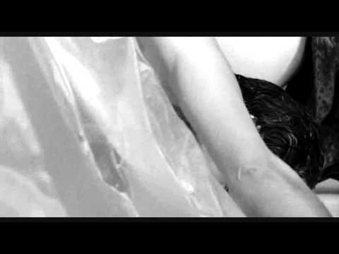
Storyboard
The Shower Scene
Psycho (1960), Alfred Hitchcock

Slide 32
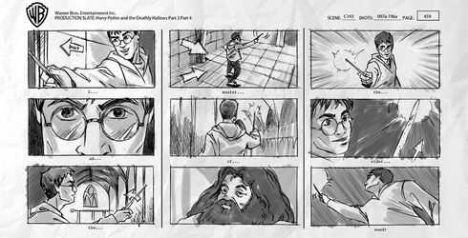
Storyboard
Harry Potter and the Deathly Hallows Part 2

Slide 33
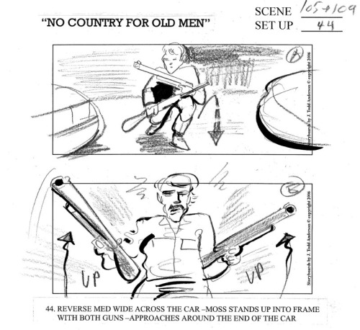
Storyboard
No Country for Old Men (2007), Joel & Ethan Coen

Slide 34
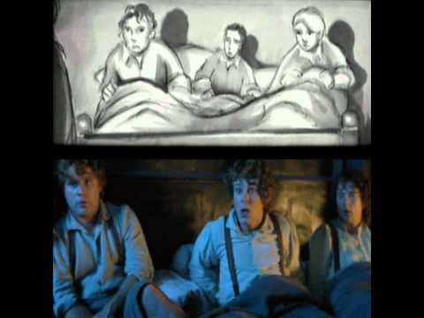
Lord of The Rings - Storyboard to Film Comparison

Slide 35
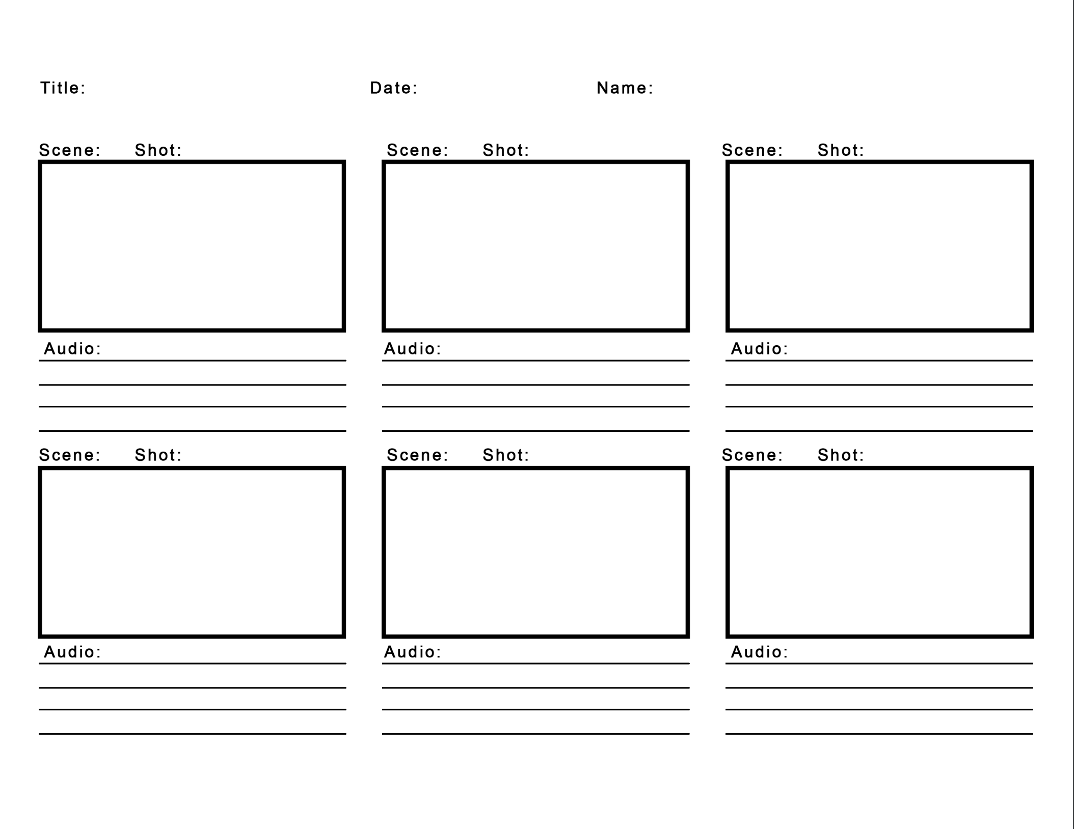

Slide 36
Final Project

Slide 37
CHANGE: The Old & The New

Slide 38
In-class Exercise: Brainstorming & Storyboarding
Begin brainstorming for the final project with your teammates. Start creating storyboards for your final project.
Be prepared to share these with the rest of your classmates tomorrow.
Teams:
Charlotte, Alan, April
Helio, Joyce, Coco
Jason, Lilly, Tenny, Olivia
Luna, Kevin, Daniel, Ashley

Slide 40
Shooting
(with camera)

Slide 41
“Make every shot a usable shot.”

Slide 42
Make Every Shot a Usable Shot
This means don’t rush!
Take the time to plan, think out, and construct.
You’ve already done this with your storyboards, but I really want to emphasize the importance of planning in the shooting process because if you don’t, you’ll waste time getting a bunch of footage that you can’t really use.

Slide 43
Most importantly,
Keep your shot STEADY!

Slide 44
Shooting: Basic Techniques

Slide 45
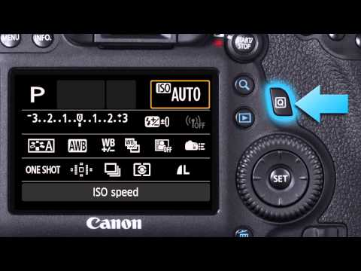

Slide 46
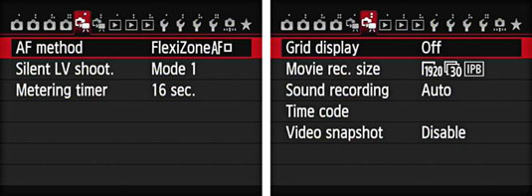
Set Recording Settings in menu.
1920 x 1080, 30 frames per second
unless intentionally doing otherwise

Slide 47
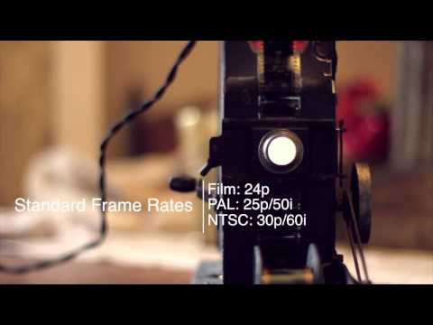
Frame Rate

Slide 48
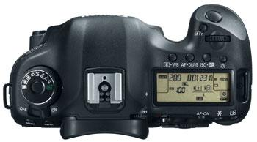
Manual Controls
Always work in manual mode (video)
Be aware of:
ISO
Aperture
Shutter speed
Focus
Make sure everything is set before you record. 6D does not allow change in mid-shoot.

Slide 49
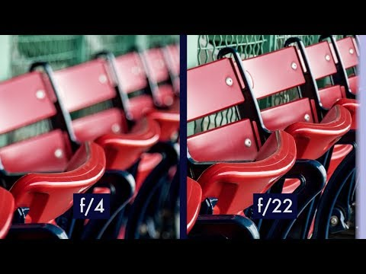
Aperture, Shutter Speed & ISO

Slide 50
DSLR Fundamentals
ISO: Camera sensitivity to light. Higher ISO is good for darker situations. If ISO is too high, your picture will look grainy. In general, keep ISO as low as possible and below 3200. Film Speed (sensitometry)
Shutter Speed: How fast the shutter opens and closes to expose the sensor to light. Recorded in fractions of a second. A speed of 1/500 opens the shutter faster than a speed of 1/50 for example.
Aperture (F-Stop): How large the hole in the lens is to allow light through. A lower aperture will allow more light in, while a higher one closes the lens more.

Slide 51
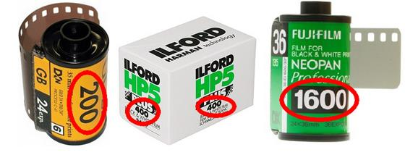
ISO: how sensitive the camera is to light

Slide 52
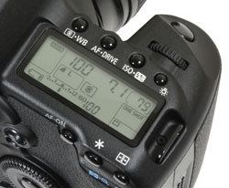
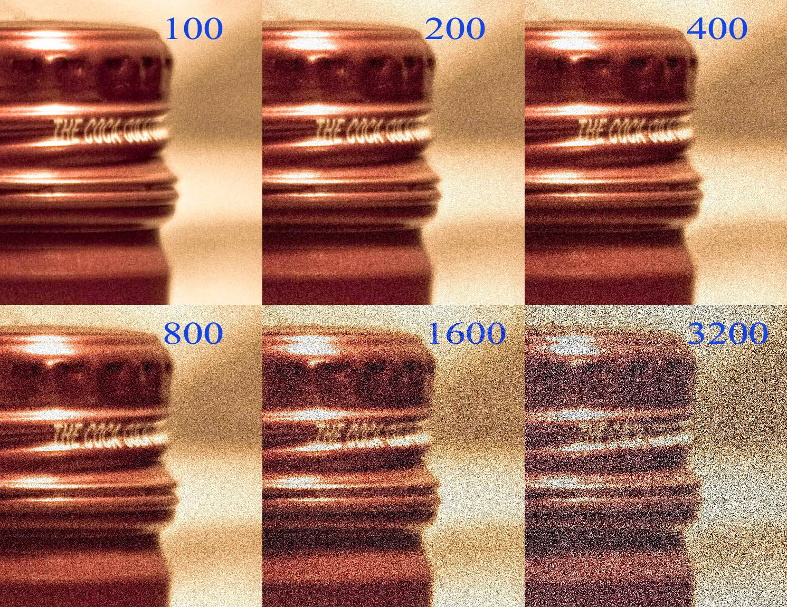
ISO: how sensitive the camera is to light

Slide 53
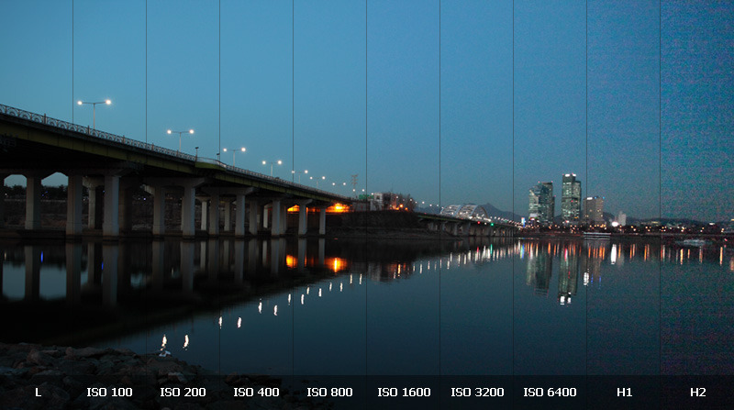
ISO: how sensitive the camera is to light

Slide 54
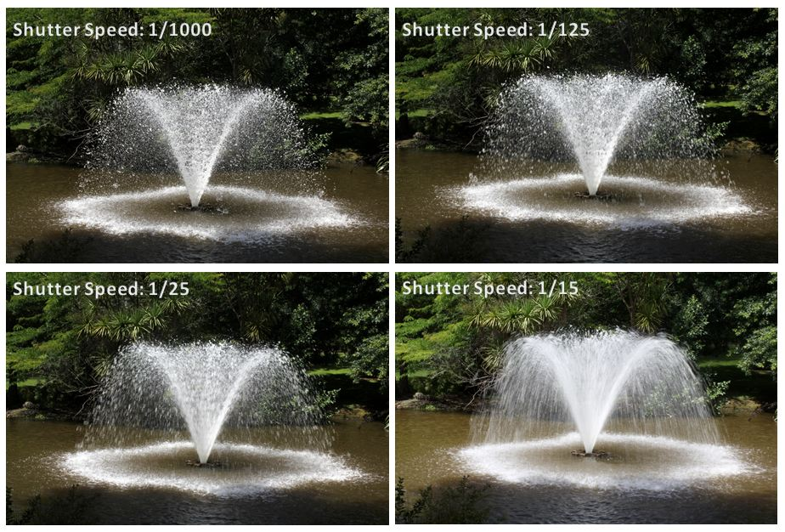
Shutter Speed: how fast the shutter is opening/closing to expose the sensor to light

Slide 55
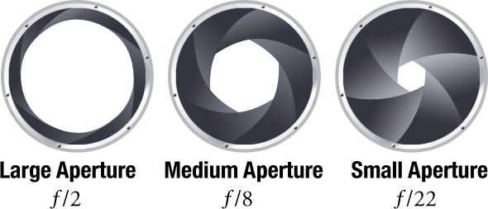
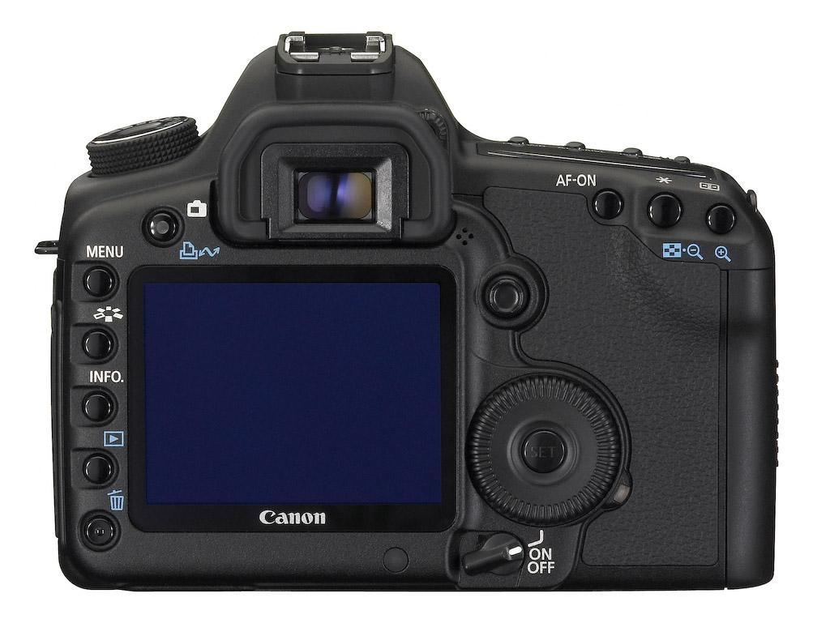
Aperture: how open the hole in the lens is to allow light through

Slide 56
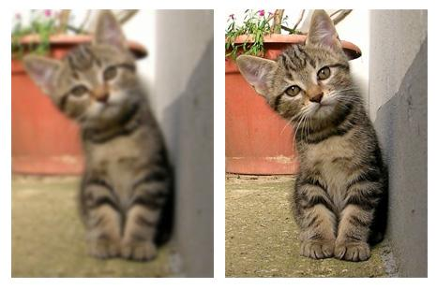
Focus
Keep footage focused at all times
Manual focus vs. Auto focus
Focus can also be used as an artistic tool

Slide 57


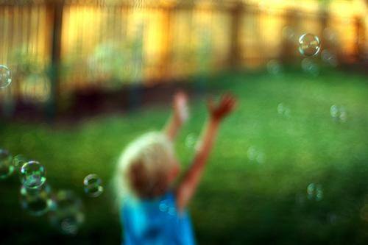

Using focus as an artistic tool

Slide 58
Zooming
Make sure it is deliberate with purpose.
Avoid using it during dialogue, interviews or tracking subjects, unless you plan on cutting out this footage later.
Too much zoom is jarring and uncomfortable.

Slide 59
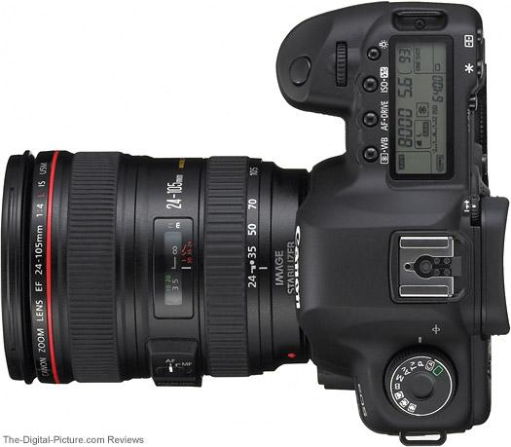
Zoom ring
Focus ring
Focusing & Zooming

Slide 60
White Balance
Depending on the characteristics of the light, the feeling of the colors on the subject differs. Thus, offsetting to make colors more white is called white balancing.
For example, a photo taken on a cloudy day has a blue tint and you can offset this by applying yellow to the colors.
In contrast, tungsten bulbs generally emit yellow light and by applying blue to the image the colors become more white.

Slide 61

White Balance
Also known as Color Balance.
Adjusts colors by sampling the whites in your image and correcting to a true-er white.
White balance can be used intentionally to influence mood or set the tone in footage.
Adjustments can still be made in post-production, but better practice to calibrate for your shoot.
Notes:
- White balance is also known as color balance. It adjusts the mixture of color in your shot according to the surrounding lighting by making white objects in your shot closer to true white.
White balance is also known as color balance. Corrects the colors in your shot based on surrounding light by making the whites in your image closer to true white.
- White balance can be used intentionally to influence mood or set the tone in footage.
- It can be adjusted in post production, but it’s better practice to make sure you’re calibrated during your shoot.
Corrections can still be made in post, but it’s best to calibrate before your first shot.

Slide 62


Slide 63


Slide 64

White Balance Example

Slide 65


White Balance
Notes:
Access the white balance through the menu options. In general, one of the presets (left) should be enough for you to shoot, and you can make small tweaks in post. In order to create a custom white balance (right), you need to first shoot an image with the approximate settings that you want.

Slide 66

Exposure
Overexposure Underexposure (Appropriate)
Exposure is the amount of light reaching the sensor.
Manually control exposure when possible using camera settings or external light.
Always use external lighting from the front, never behind (unless purposefully)
overexposure
underexposure
Appropriate
Notes:
- Exposure is the amount of light getting through to the sensor. You can adjust this in the camera settings or by adding or removing external light.
- Manually control your exposure when possible.
- If you decide to add external light, make sure your subjects are lit from the front, and NEVER behind (unless it’s a deliberate choice).
If you decide to use external lighting, always light from the front, never from behind unless it’s purposeful. Depending on how you light your subject, you can set the mood, cast shadows, etc.

Slide 67


Lighting from behind

Slide 68


Lighting
LED Light Panel Gives the whole room/area a boost of light (needs stand)
Ring Light Light attaches to lens of camera.
For giving light to profile faces.

Slide 69


Exposure

Slide 70
Exposure
Light | Aperture | Shutter Speed | ISO | Exposure
Strength of Light | Amount of light that the sensor(film) receives per certain time (Size of aperture hole) | Amount of time that the sensor(film) accepts light | Sensitivity of sensor(film) | Result
Daylight Cloudy Strobe (flash) light Tungsten light | f1.4 f1.8 f16 f22 | 2 1 / 16 1 / 32 1 / 6400 (sec) | 100 200 400 800 | +2 0 -1 -2

Slide 71
Exposure
Light | Aperture | Shutter Speed | ISO | Exposure
Strength of Light | Amount of light that the sensor(film) receives per certain time (Size of aperture hole) | Amount of time that the sensor(film) accepts light | Sensitivity of sensor(film) | Result
Daylight 1.0 | f4 1.0 | 1/4 1.0 | 100 1.0 | 0 (Normal Exposure) 1.0
Let’s assume that with these settings you can get normal exposure.

Slide 72
Exposure
Light | Aperture | Shutter Speed | ISO | Exposure
Strength of Light | Amount of light that the sensor(film) receives per certain time (Size of aperture hole) | Amount of time that the sensor(film) accepts light | Sensitivity of sensor(film) | Result
Daylight 1.0 | f4 1.0 | 1/4 1.0 | 100 1.0 | 0 (Normal Exposure) 1.0
x x x =
Let’s assume that with these settings you can get normal exposure.

Slide 73
Exposure
Light | Aperture | Shutter Speed | ISO | Exposure
Strength of Light | Amount of light that the sensor(film) receives per certain time (Size of aperture hole) | Amount of time that the sensor(film) accepts light | Sensitivity of sensor(film) | Result
Daylight 1.0 | f4 1.0 | 1/8 0.5 | 100 1.0 | -1 (Under Exposure) 0.5
But you want the shutter speed twice faster, then it becomes under-exposed.

Slide 74
Exposure
Light | Aperture | Shutter Speed | ISO | Exposure
Strength of Light | Amount of light that the sensor(film) receives per certain time (Size of aperture hole) | Amount of time that the sensor(film) accepts light | Sensitivity of sensor(film) | Result
Daylight 1.0 | f2.8 2.0 | 1/8 0.5 | 100 1.0 | 0 (Normal Exposure) 1.0
You can make the exposure normal again by adjusting the aperture.

Slide 75
Exposure
Light | Aperture | Shutter Speed | ISO | Exposure
Strength of Light | Amount of light that the sensor(film) receives per certain time (Size of aperture hole) | Amount of time that the sensor(film) accepts light | Sensitivity of sensor(film) | Result
Daylight 1.0 | f4 1.0 | 1/8 0.5 | 100 1.0 | -1 (Under Exposure) 0.5
Also, you can make the exposure normal by changing other aspects, such as changing the light source or ISO setting.

Slide 76
Exposure
Light | Aperture | Shutter Speed | ISO | Exposure
Strength of Light | Amount of light that the sensor(film) receives per certain time (Size of aperture hole) | Amount of time that the sensor(film) accepts light | Sensitivity of sensor(film) | Result
Daylight 1.0 | f4 1.0 | 1/8 0.5 | 200 2.0 | 0 (Normal Exposure) 1.0
The sensitivity of the sensor can be doubled as ISO increases to 200, and you can get the normal exposure again.

Slide 77
Review

Slide 78



Light

Slide 79

Aperture

Slide 80

Shutter Speed

Slide 81
ISO

Slide 82


Depth of Field (DOF)
Shallow Depth of Field
Large hole(aperture), Fast shutter speed
Deep Depth of Field
Small hole(aperture), Slow shutter speed

Slide 83

Summary

Slide 84

Summary

Slide 85
In The Field
Keep a checklist that you can refer to before recording.
Use a tripod. If you must shoot handheld (not recommended when first starting), try and steady your arms on something to minimize shakiness.
Make sure you have extra of everything: batteries, memory cards, etc. Make sure there’s enough space or fully charged.
TAKE NOTES! If there are multiple takes of the same thing, mark which one was the best. Write down the content of each shots. This will be helpful for post-production.

Slide 87
Audio

Slide 88
Good Audio? Bad Audio?
People will forgive mediocre or bad visuals.
They will not forgive bad audio!

Slide 89

Tascam DR-40 Field Recorder
Tascam recorders operate on batteries and are designed to be portable, so it is adequate to be used outdoors, such as for capturing ambient sound.
Tascam recorder saves on to an SD card, and the card is ejectable to be plugged into your computer for file transfer.
Tascam recorders have 2 internal microphones, but it is also possible to connect up to two external microphones.

Slide 90

Tascam DR-40 Field Recorder
MONO - one microphone
Options:
Internal Microphone
External Line 1 ( = Left)
STEREO - left and right channel (2 microphones)
Options:
Internal Microphone
External Line 1 / 2 (Both Left and Right)

Slide 91


Slide 92
Pre-recording Checklist (1)
Format SD card
MENU > OTHERS > SYSTEM > QUICK FORMAT
Check battery levels
Check file format (16-bit 44.1hz WAV)
MENU > REC SETTING
Input level at 80 (adjust if needed)
INPUT LEVEL buttons on the left side of Tascam
Hold is set to “off”
HOLD button on the left side of Tascam

Slide 93
Pre-recording Checklist (2)
Connect / Wear headphones
LINE OUT jack on the left side of Tascam
Set to standby mode and check the levels
Press RECORD button once and see blinking light
Record 5 -10 seconds of “room tone”
Room Tone: The silent state of the recording space
Record before and after the desired sound
For using as silence gaps and noise reduction

Slide 94
Steps of Recording with Tascam
Press POWER button
Review Settings
Press RECORD (standby mode)
CHECK LEVELS !
Press RECORD again
Press STOP to finish

Slide 95

Levels
Too much sound (loud) / Peaking = Distorted sound information
To Adjust:
Move microphone physically closer
Adjust INPUT LEVEL
Ideal range of level

Slide 96

Vocal Microphone
Vocal Microphone is good for recording speech or vocals. This is a standard microphone that you would see on stage, interviews and karaoke.
When you are using the vocal microphone with Tascam field recorder, please make sure that the External In (EXT IN) setting is set to MIC and Record Mode (REC MODE) is set to MONO with EXT LINE 1.

Slide 97

Shotgun Microphone
Shotgun Microphone is good for recording focused sounds in surroundings, both indoor and outdoor. It provides the narrow acceptance angle desirable for long-distance sound pickup, featuring sound rejection from the sides and rear of microphone.
Shotgun Microphone operates on battery or phantom power. When using with Tascam recorder, make sure that the External In (EXT IN) setting is set to MIC + PHANTOM before connecting the microphone.

Slide 98
Set External In (EXT IN) to MIC + PHANTOM
BEFORE connecting the microphone.

Slide 99

Audio Recording when shooting
Use the Tascam field recorders and mics simultaneously with the DSLRs, because the audio on the DSLRs is not great.
However, DO still record audio from the DSLR, because this will help you sync things up in post production.

Slide 100
Audio Recording Tips
Room tone. Capture 10-20 seconds of silence in the room before or after takes.
Always have one person monitoring audio
Watch out for loud noises: airplanes, traffic, loud music. Hold off on recording until they pass (unless it’s deliberate).
Clap to sync audio on camera with audio recorder!

Slide 101

Clap to sync audio!

Slide 102
For Tomorrow
Prepare to share your final project idea with the class using your storyboards.

